Slide 1
School of Education
INDIANA UNIVERSITY
Faculty Meeting
Friday, November 9, 2018

Slide 2
Welcome

Slide 3
Agenda
10am Welcome
10:05 Dean’s Report
10:10 Otting Chair Presentation
10:15 Leadership Updates
11am Opening Conversations for Strategic Planning (Small Groups)
11:50 Wrap-up, Q&A, Closing
Noon Lunch on the balcony (R&D Poster Session)

Slide 4
New Faculty 2018-19
Fetiye Aydeniz- Visiting Assistant Professor in the Department of Curriculum and Instruction.
Walter Bourke- Clinical Assistant Professor in the Department of Education Leadership and Policy Studies.
Daniel Castner- Assistant Professor in the Department of Curriculum and Instruction.
Alycia Elfreich- Clinical Assistant Professor in the Department of Curriculum and Instruction.

Slide 5
New Faculty 2018-19
Elizabeth Holcombe- Visiting Research Associate in the Center for Postsecondary Research
Tina O’Neal- Clinical Assistant Professor in the Department of Curriculum and Instruction.
Zoë Peterson- Associate Professor in the Department of Counseling and Educational Psychology and will also serve as an Associate Scientist at the Kinsey Institute for Research in Sex, Gender and Reproduction.
Amy Pickard- Assistant Professor of Adult Education in the Department of Instructional Systems Technology.
Gary Pike- Professor of Higher Education and Student Affairs in the Department of Educational Leadership and Policy Studies.

Slide 6
New Faculty 2018-19
Abeera Rehmat- Postdoctoral position in the Center for Research on Learning and Technology.
Jennifer Rippner- Visiting Lecturer in the Department of Education Policy and Leadership Studies.
David Shriberg- Professor in the Department of Counseling and Educational Psychology.
Erik Tillema- Associate Professor in the Department of Curriculum and Instruction.
Kelly Williams- Assistant Professor in the Department of Curriculum and Instruction.

Slide 7
Otting Chair in Special Education
Gretchen Butera

Slide 8
Save The Date – Upcoming Events
  Saturday, December 8
  Winter Holiday Celebration
  6:30pm | President’s Hall, Franklin Hall
  Saturday, December 15
  Convocation
  12:45 | Atrium

Slide 9
Save The Date - 2019 Faculty Meetings
  Friday, February 15
  10am – Noon | Auditorium
  Friday, April 26
  10am – Noon | Auditorium

Slide 10
Lemuel Watson
Dean

Slide 11
Personal Philosophy
I Believe . . .
in treating others as I would have them treat me.
in the values of honesty, respect, empathy, sincerity, compassion, and care.
in the spirit of love and kindness.
in humility regardless of my accomplishments.
in something that is bigger than myself who guides my life and the universe.
that everyday is a gift, and I am grateful for it.

Slide 12
Leadership Philosophy
As a leader, it is important to listen and to employ various strategies to help people make informed and empowering decisions.
I also believe in the power of positive thinking and team work to address challenging obstacles. I make every attempt to inspire faculty to look for opportunity and new ways of doing things.
I embrace shared governance and stress that we are accountable for our actions as professionals to each other. I consider myself first among equals.
I believe in the democratic process and taking time to have courageous dialogs about important issues. Every voice is important and should be allowed to contribute to the discourse. Creating great teams require psychological safe space (trust, value, and respect).

Slide 13
Opportunities & Challenges
Define a distinctive identity for the School, one which incorporates scholarly excellence, service, and global presence into a cohesive vision for the future
Innovate to grow enrollment, attract top undergraduate and
graduate students, and ensure long-term sustainability

Slide 14
Opportunities & Challenges
Assess and refine the School’s infrastructure to enhance support for students, cultivate faculty, and encourage collaboration across departments and programs
Forge strong relationships with partners across campus
and the educational community in Indiana and beyond

Slide 15
Opportunities & Challenges
Manage a complex enterprise and grow the financial resources of the School
Advance commitment to diversity, inclusion, and social justice of the School

Slide 16
Jill Shedd
Assistant Dean for Teacher Education

Slide 17
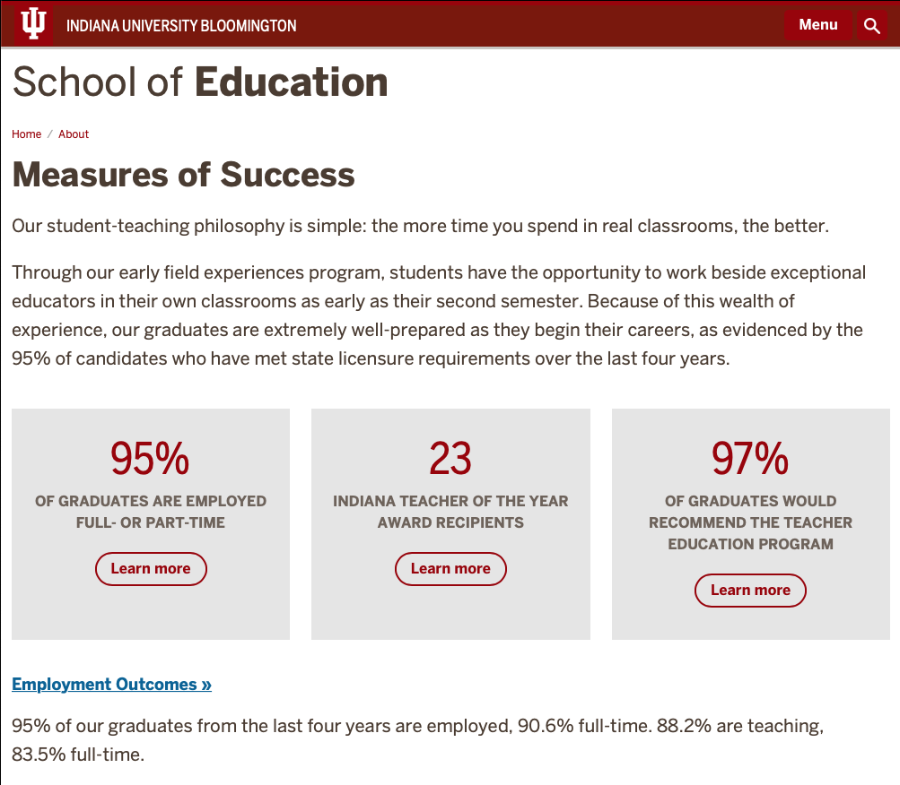
Portrait of Teacher Education
Measures of Success
https://education.indiana.edu/about/measures-of-success/index.html

Slide 18
Enrollment
907
875
813
683
632
Note:
Certification from
University Division
began fall 2016
Source: Tableau
https://tableau.bi.iu.edu/t/prd/views/BloomingtonEnrollmentsbySchoolandMajor/MajorsbySchoolTable?:embed=y#1 10.31.18

Slide 19
Teacher Education/
Undergraduate Recruitment Initiatives
Indiana high school efforts
Refinement/Marketing of BS/MS Collaboration with the COAS
Development of new undergraduate major
Efforts to revise the Transition to Teaching program as a hybrid program

Slide 20
School Community/Partnership Efforts
Retention/School of Education Community
Mentor Collective
New academic advising initiatives
Student Teacher Send-off Celebrations
Professional Development series

Slide 21
School Community/Partnership Efforts
P-12 Partnership Initiatives
Career Connections Advisory Councils
Networking Nights
Student Teaching Residencies

Slide 22
Impact on state of Indiana
88.2% of graduates over the past four years are teaching;
the vast majority in the state of Indiana
Teacher candidates in 42 of 92 counties
45 different Indiana school corporations attending annual Interview Day (total of 62 in attendance)

Slide 23
Impact on state of Indiana
Employers comments:
  “I like the enthusiasm and level of professionalism all the preservice teachers brought to the table.”
  “The candidates were very well prepared and qualified. I was impressed by the quality of prospective teachers you're producing.”
  “This was the strongest group of candidates I've seen from any hiring fair I've attended. “

Slide 24
Candidates’ Voice
Persistent Themes
More field experiences
More/Better integration between education classes and field experiences in the schools.

Slide 25
Candidates’ Voice
Graduates (2014-2015)
Students would benefit from having more field experience. I learned the most when I was in the schools.
Having teaching professors who were once teachers is so important and beneficial to future educators. I do think more time in classrooms would benefit the future teachers.
I would recommend having the secondary education program provide students with more field work experience.

Slide 26
Jeff Buszkiewicz
Director of Business Affairs and Budget

Slide 27
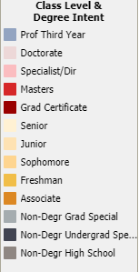
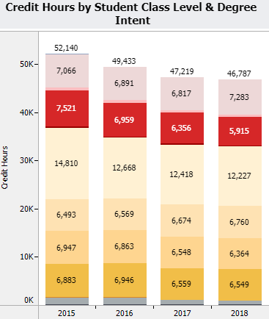
Four Year History of Credit Hours
Total Credit Hours -10.3%
Doctorate Credit Hours 3.1%
Master’s Credit Hours -21.4%
Undergrad Credit Hours - 9.2%
Net General Funding - 5.9%

Slide 28
General Fund Trends

Slide 29
Where our funding comes from

Slide 30
Where our funding goes

Slide 31
What happens to a surplus
Faculty research funds
Faculty travel
Special events sponsorships
  African American Read-In
  Special event/lecturer visits
  Campus writing groups
  African American Chorale Ensemble
  Grad student conference
  Diversity Committee events
  Martin Luther King day events
Special Programs
  LTT grant program
  Start Over Funding program
  IAPSS (support of Indiana Association of Public School Superintendents) events
  Effective Leaders Academy
  Faculty Success Program
  CLACS Field Research Grants

Slide 32
What happens to a surplus
Financial Aid
Direct Admit Scholarships
Graduate Student Recruitment
Graduate Fellowship support

Slide 33
What happens to a surplus
SoE Renovations
Makerspace (MILL)
Suite 1000 (OTE)
Conference room technology upgrades
Classroom technology upgrades
Classroom chairs
Auditorium remodel
Renovations of 2140 and 2277

Slide 34
Mary Dwyer
Executive Director of Development and Alumni Relations

Slide 36
Ginette Delandshere
Interim Executive Associate Dean

Slide 37
IUB Faculty Numbers 2014-2018
 | Tenure Track | Tenure Track Faculty of Color | Non-Tenure Track | Non Tenure Track Faculty of Color | Research Scientist | Research Sci Faculty of Color | Total Faculty | Total Faculty of Color
2018 | 93 | 23% | 14 | 14% | 14 | 14% | 121 | 21%
2017 | 95 | 24% | 14 | 0 | 16 | 13% | 125 | 20%
2016 | 92 | 23% | 15 | 0 | 16 | 13% | 123 | 19%
2015 | 94 | 21% | 17 | 1% | 14 | 7% | 125 | 18%
2014 | 96 | 22% | 15 | 1% | 15 | 7% | 126 | 18%

Slide 38
IUB Faculty Numbers 2014-2018
Faculty Numbers by Academic Appointment

Slide 39
IUB Faculty Numbers 2014-2018
Percent Faculty of Color Status by Academic Appointment

Slide 40
IUB Faculty Numbers 2014-2018
Year | Full Prof | Associate Prof | Assistant Prof | Clinical/ Lecturer | Research Scientist
2018 | 34 (9%) | 45 (31%) | 14 (29%) | 14 (14%) | 16 (13%)
2017 | 32 (9%) | 47 (34%) | 16 (25%) | 14 (0%) | 16 (13%)
2016 | 33 (9%) | 45 (33%) | 14 (21%) | 15 (0%) | 16 (13%)
2015 | 37 (5%) | 45 (36%) | 12 (17%) | 17 (6%) | 14 (7%)
2014 | 37 (8%) | 43 (35%) | 16 (19%) | 15 (7%) | 15 (7%)
Note: (%) = percent of
individuals identifying as
a racial/ethnic minority

Slide 41
IUB Faculty Numbers 2014-2018
Faculty Numbers by Rank

Slide 42
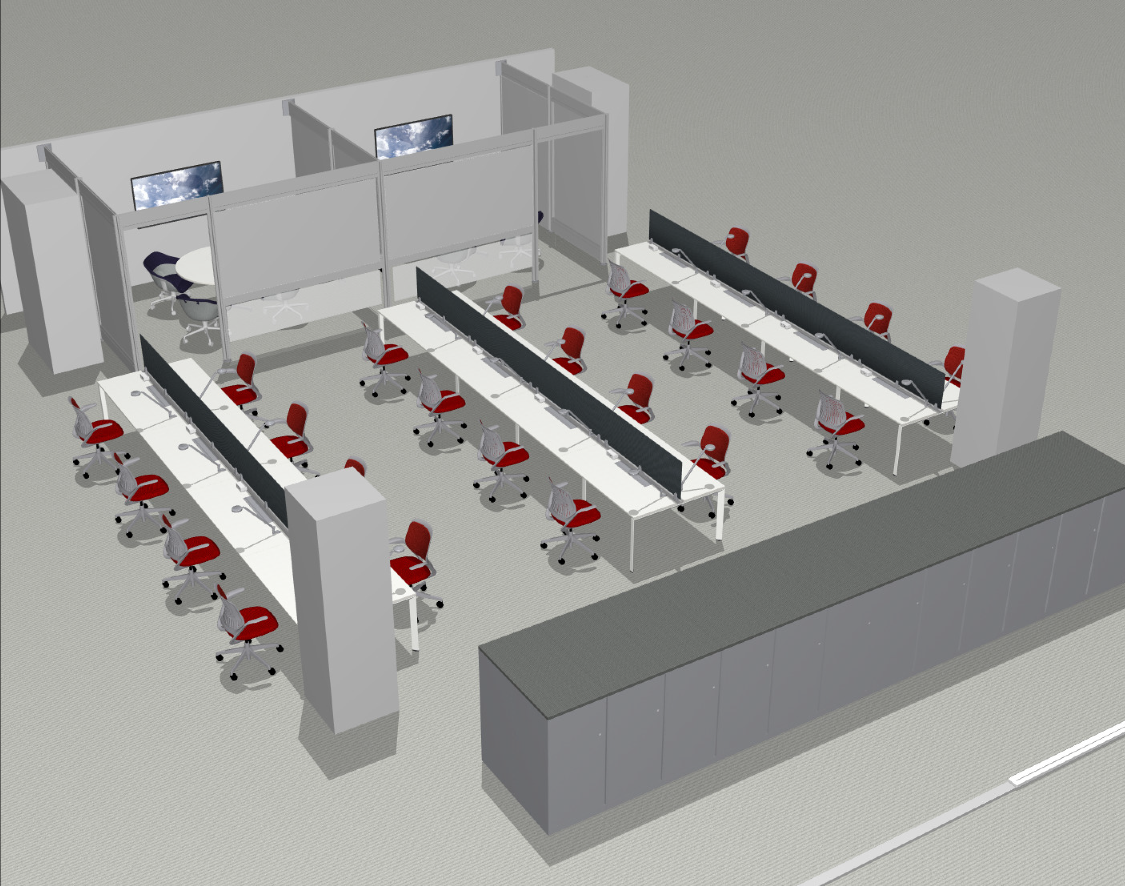

Slide 43
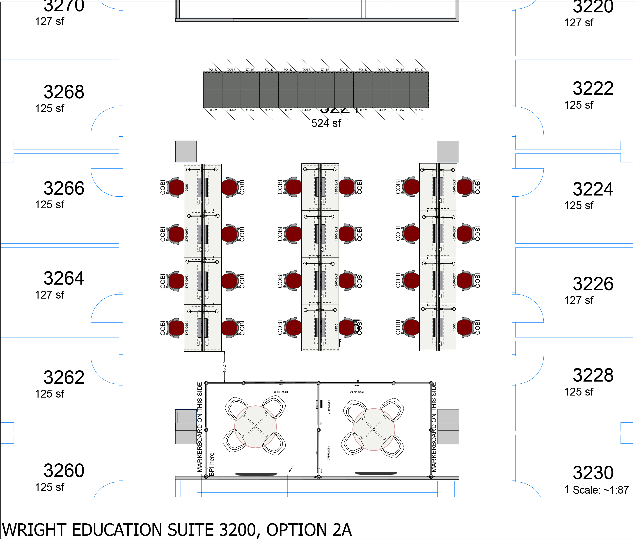

Slide 44
Gayle Buck
Associate Dean of Research

Slide 45
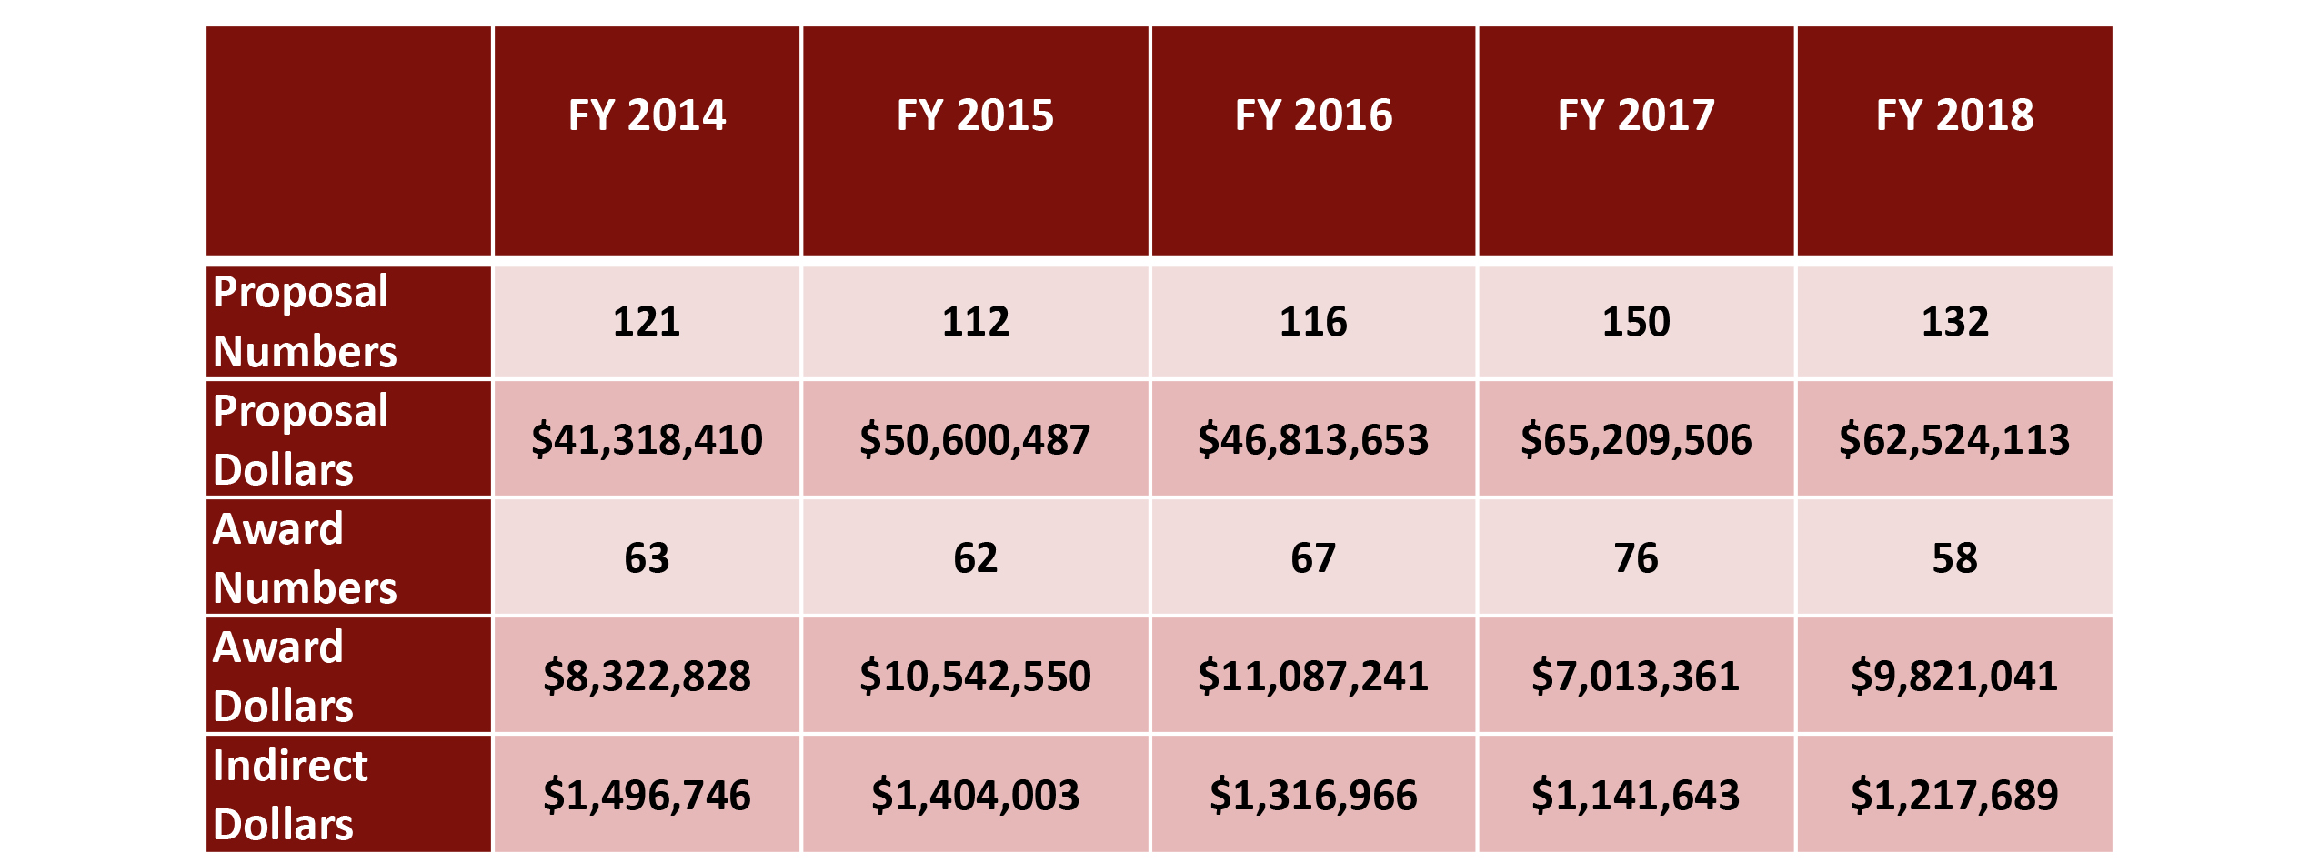
Sponsored Research Trends (FY14-FY18)

Slide 46
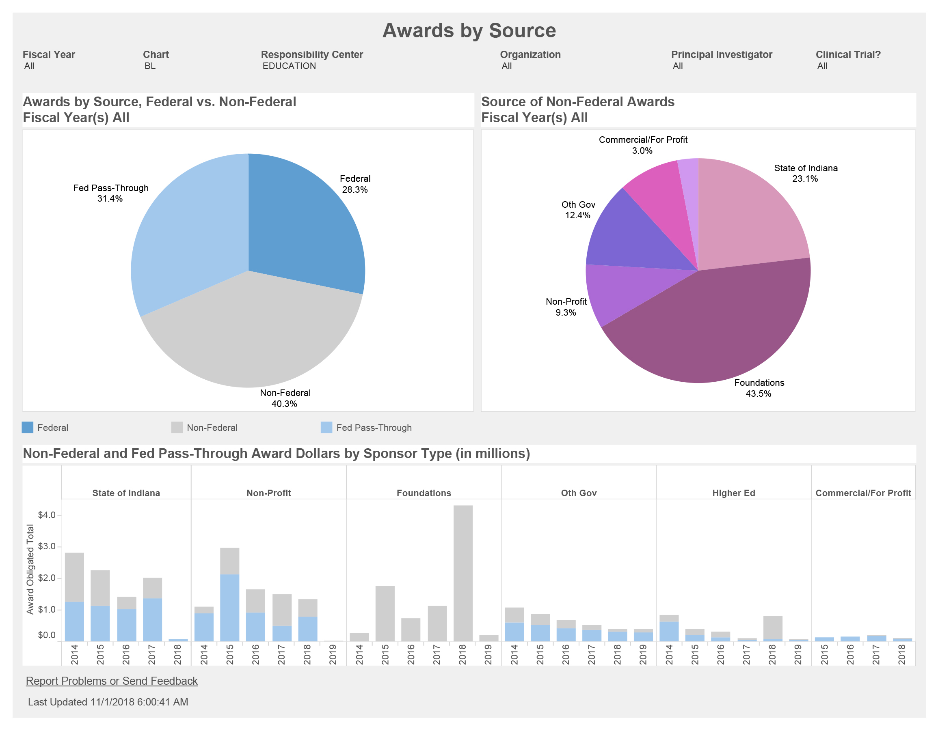

Slide 47
Internal Grants List
Proffitt Internal Grant (Deadline: December 14, 2018) $19,000
Proffitt Summer Faculty Fellowship (Deadline: December 14, 2018) $10,000
Kempf Internal Grant (Deadline: December 14, 2018) $18,000
Creative Paths to Peace Internal Grant (Deadline: December 14, 2018) $19,000
Martha and H.A.R. Tilaar Internal Grant (Deadline: December 14, 2018) $10,000 max
Research Proposal Incentive Fund (Deadline: February 1, 2019)
Start Over Funds (Deadline: None)

Slide 48
2018 R&D Brown Bag Sessions
Spring 2018
Human Subjects: How to submit initial and post approval review requests through KC Beth Johnson and Adam Mills, Research Compliance Office
Indirect Costs: what are they, why we have them, and how they work
Sam Tirey, Assistant Director, SoE Research and Development Office
Grant Budgeting, allowable costs, budget narrative, and agency templates
Sam Tirey, Assistant Director, SoE Research and Development Office
Grant Documents: necessary materials for a successful grant submission
Sam Tirey, Assistant Director, SoE Research and Development Office

Slide 49
2018 R&D Brown Bag Sessions
Fall 2018
IU Human Subjects
Adam Mills, Research Compliance Office
Foundation Grants
Mary Dwyer, Executive Director of Development and Alumni Relations, SoE, and Cory Rutz, Director of Foundation Relations, Office of the Vice President for Research

Slide 50
2018 R&D Events
Fall
Poster Session on Internal Awards
Poster Session on SoE Research Centers

Slide 51
Sarah Lubienski
Interim Associate Dean for Graduate Studies

Slide 52
Graduate Student Demographics

Slide 53
Fall 2018 by Degree and Department

Slide 54
Online M.S.Ed and Ed.D.

Slide 55
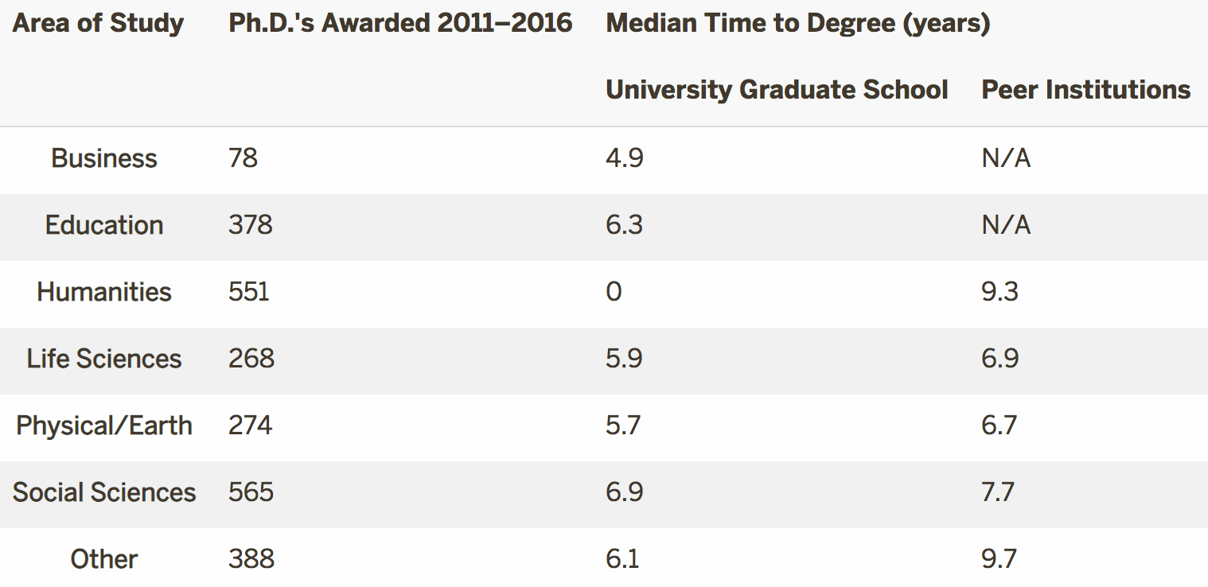
Median Time to Ph.D. (source: UGS Website)

Slide 56
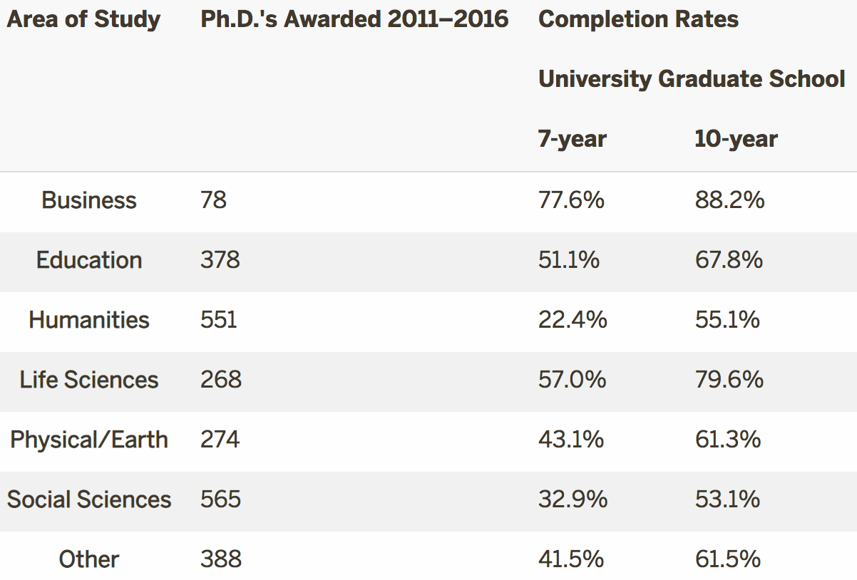
Completion Rates (source: UGS Website)
(source: UGS Website)

Slide 57
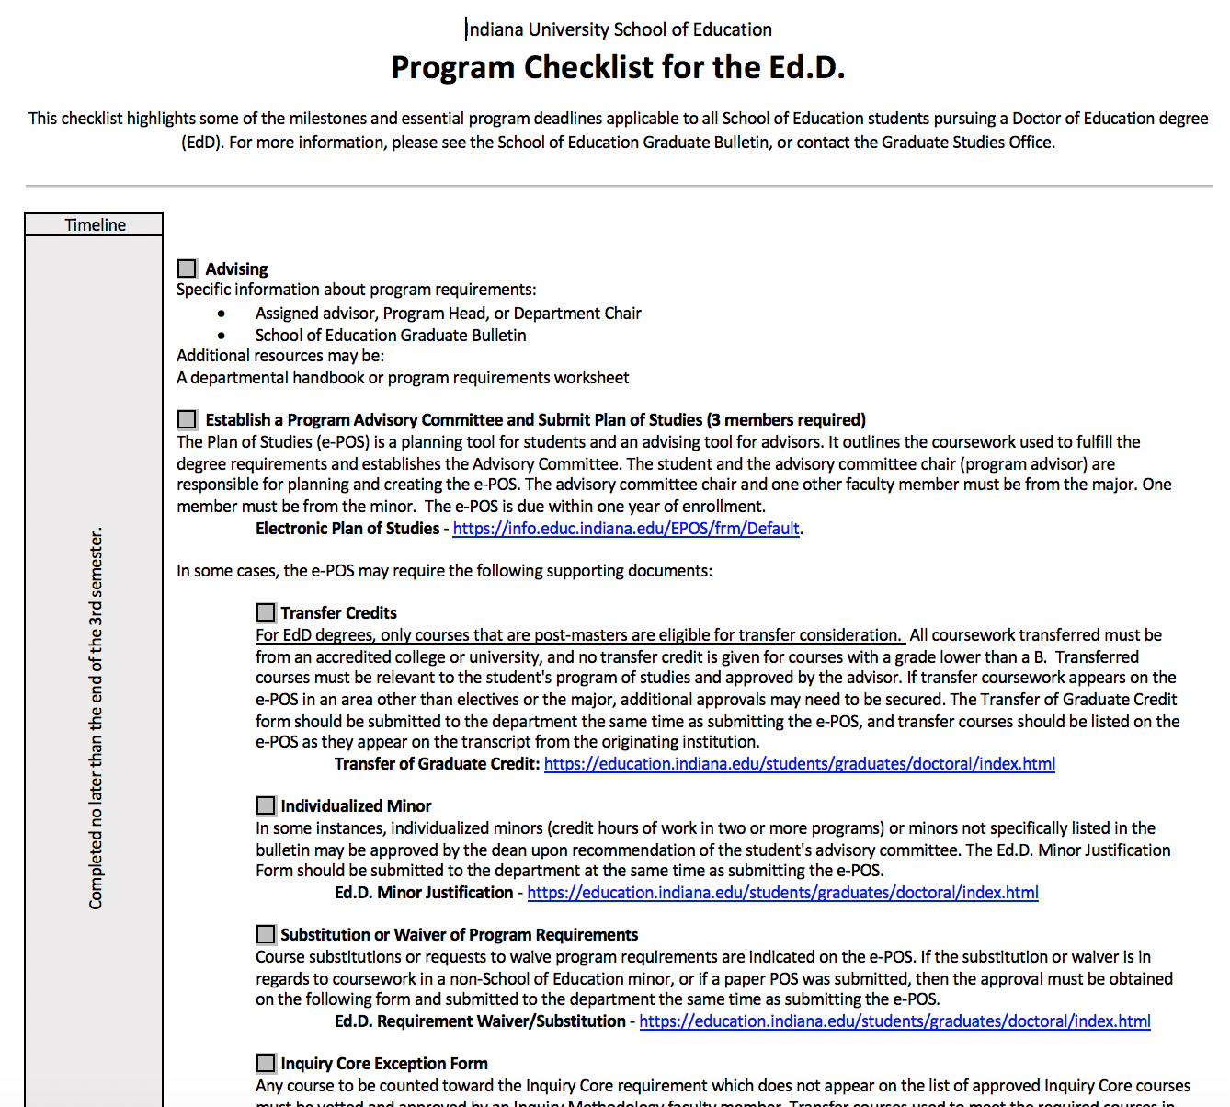
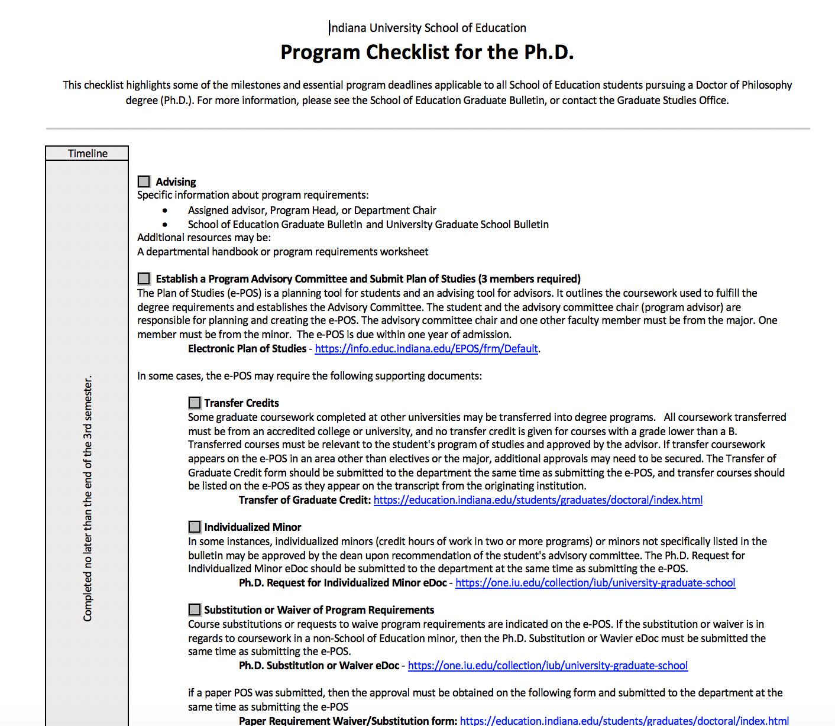
Coming Soon to your inbox…

Slide 58
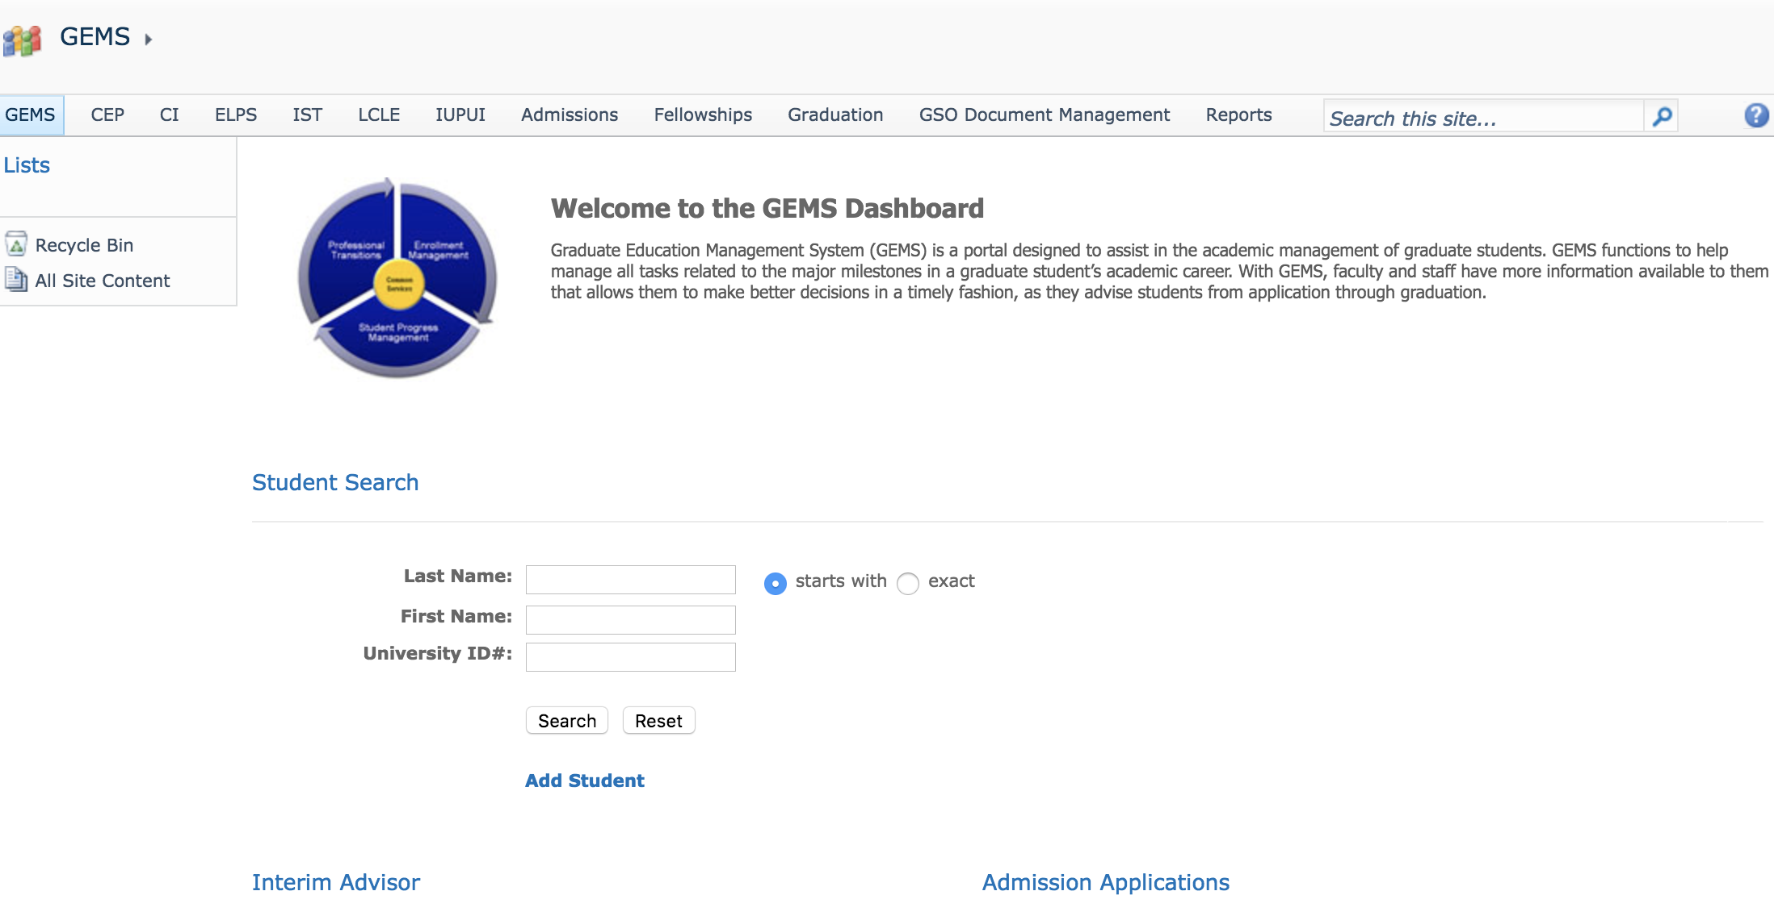
Find Your List of Advisees and Key Info in GEMS

Slide 59
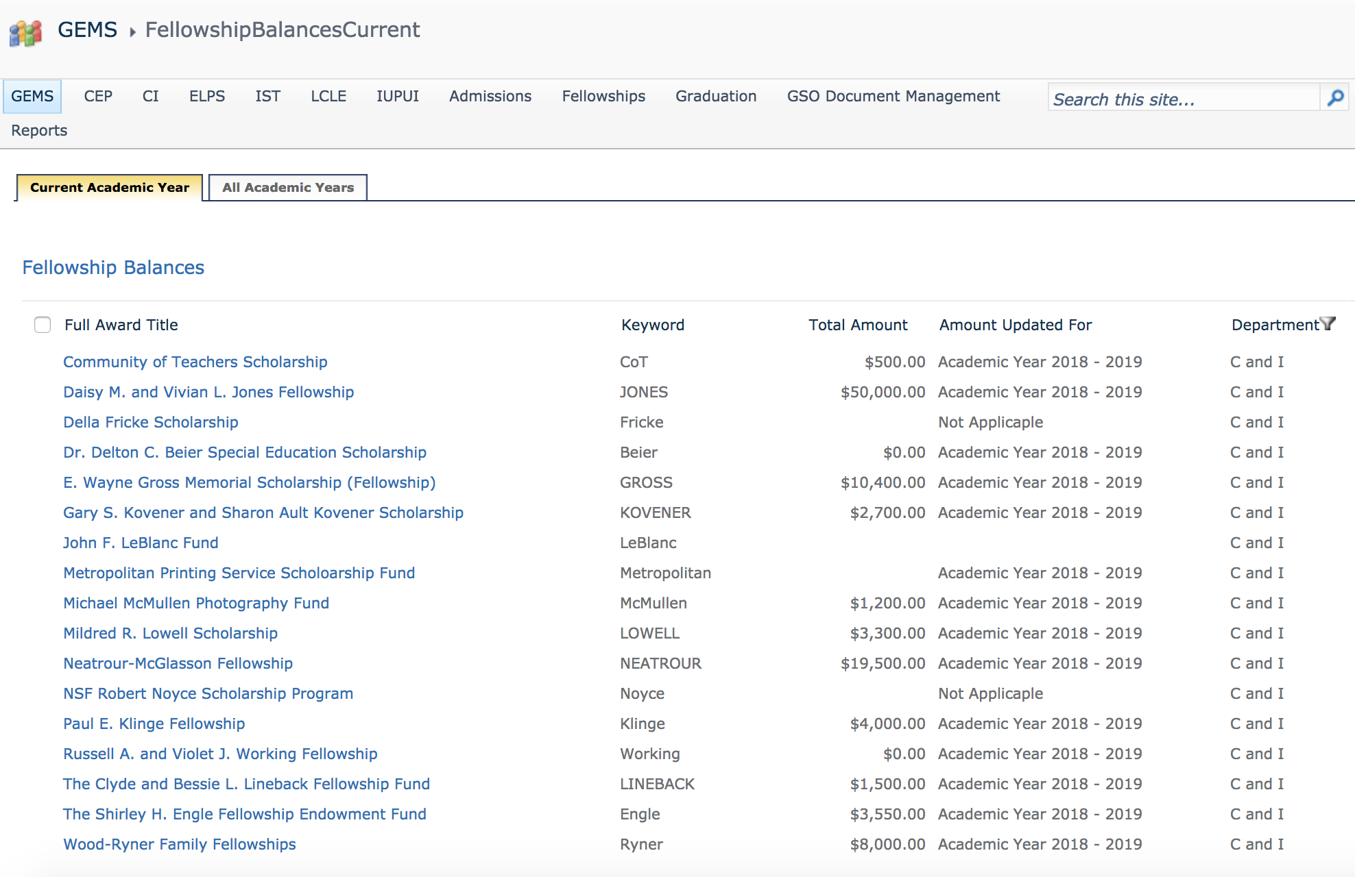
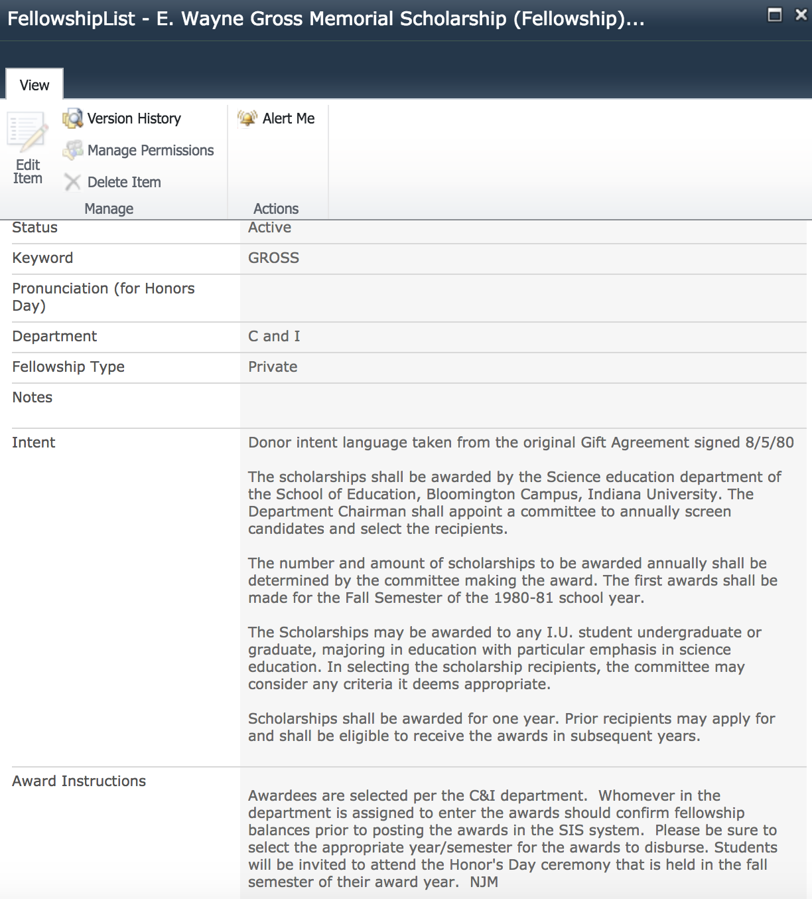
Did You Know Fellowship Info is in Gems?

Slide 60
Multiple Article Dissertation?

Slide 61
Multiple Article Dissertation?
Although work published by the student may be incorporated into the dissertation, a collection of unrelated published papers, alone, is not acceptable. There must be a logical connection between all components of the dissertation, and these must be integrated in a rational and coherent fashion. It is the responsibility of the student’s research committee to determine the kind and amount of published materials which may be included in a dissertation.
                -UGS Bulletin

Slide 62
Scott Witzke
Director of Marketing and Communications

Slide 63
Updates…
Website
  Submit News Story
  Update Faculty Records
  Update CV
  Submit Spring Events

Slide 64
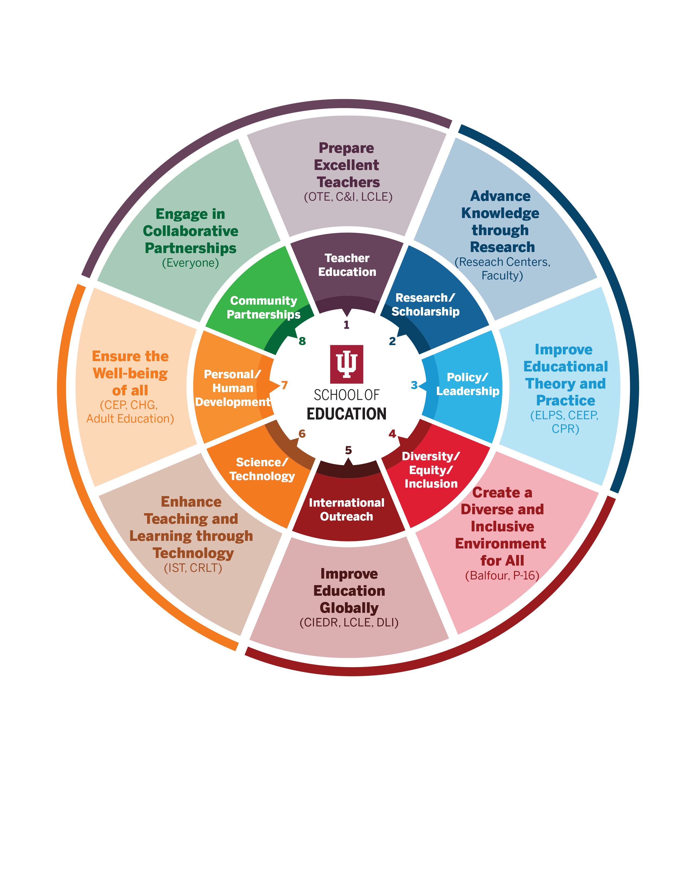

Slide 65
Lemuel W. Watson
Dean

Slide 66
Strategic Planning Process - Timeline
November
16 (FRI) Deadline to Sign up for Focus Groups
28 (WED) Focus Groups
29 (THU) Focus Groups
30 (FRI) Focus Groups

Slide 67
Strategic Planning Process - Timeline
December
Early DEC Launch Online Survey
4 (TUE) Large Conference Call
21 (FRI) Online Survey Deadline

Slide 68
Strategic Planning Retreat
Thursday, January 17, and Friday, January 18, 2019
University Club, Indiana Memorial Union
8:00 a.m. to 4:30 p.m.

Slide 69
General Questions
What do you see as the key strengths of the School of Education?
What do you see as the School of Education’s weaknesses/areas of needed improvement?
What are the critical issues that the School of Education needs to face over the next three to five years?
What do you see as the key priorities the School of Education should establish in its strategic plan?

Slide 70
Group Session

